Slide 1
Welcome to Neo Flow
曹家齐

Slide 2

1
Motivation
2
App Introduction
3
Live Demo
4
Summary

Slide 3
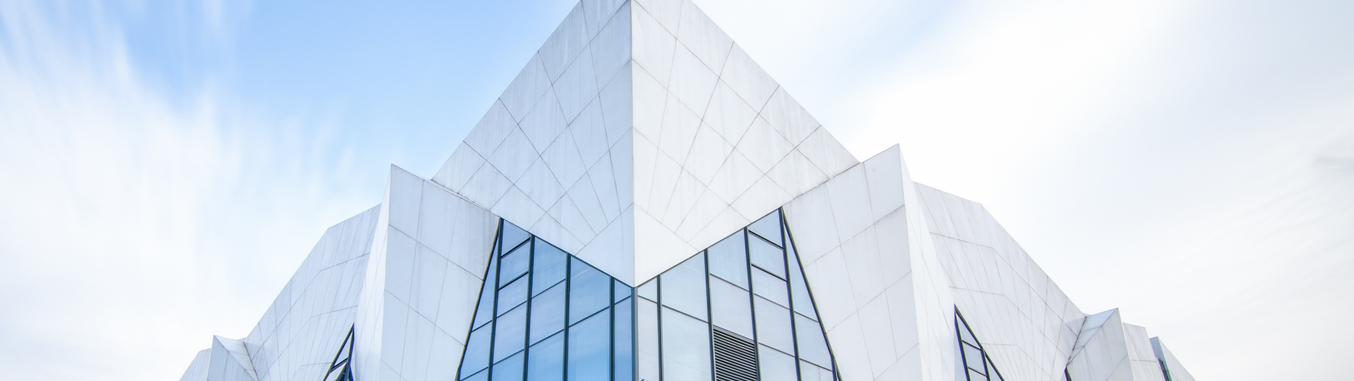
Motivation
01
Why make another Get Things Done App while there already are so many ?

Slide 4
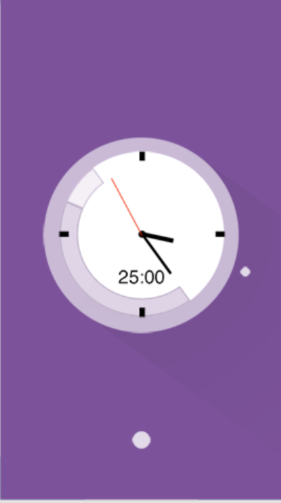
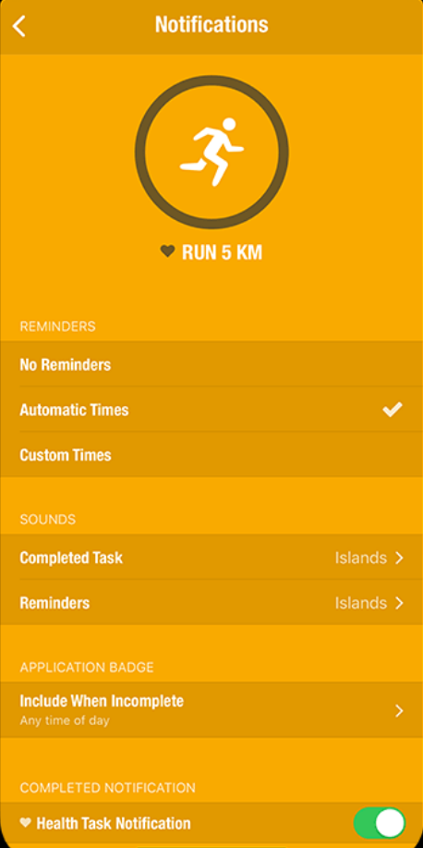
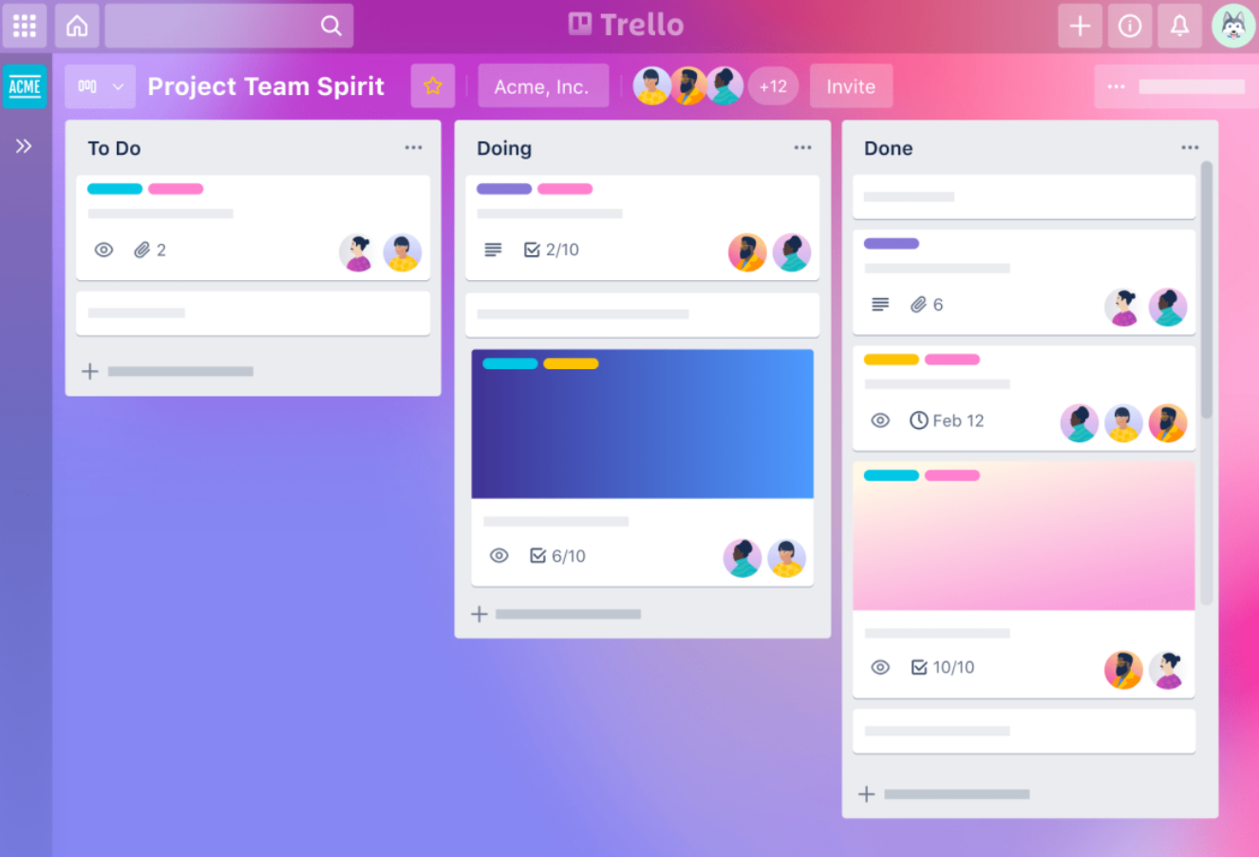
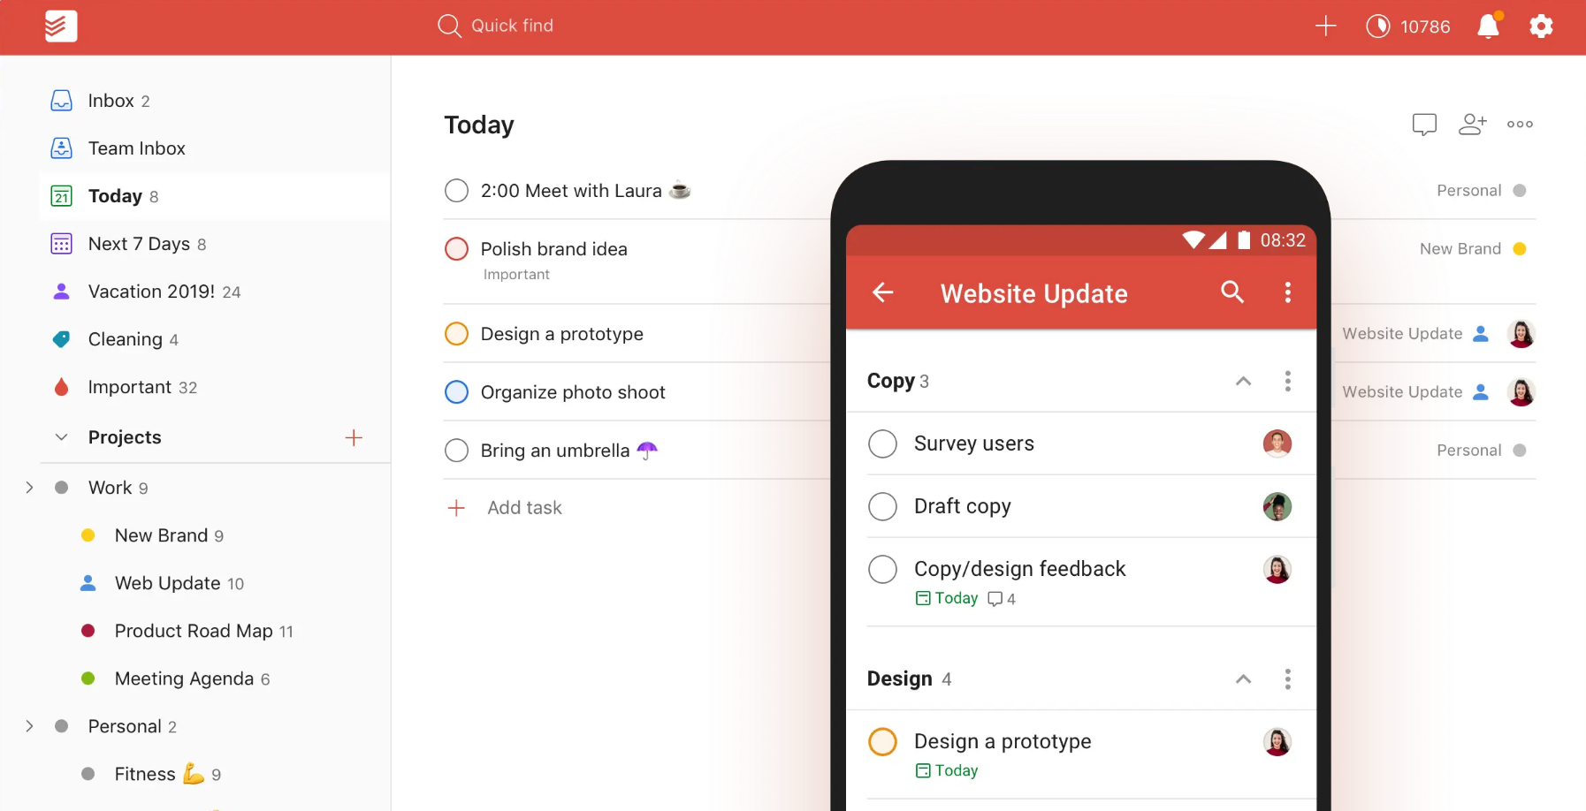
Motivation
Flat Tomato:
A pomodoro APP
Streaks:
A Habit Traking APP
Trello:
A Project Management App
Todoist:
A To-do Memo APP

Slide 5
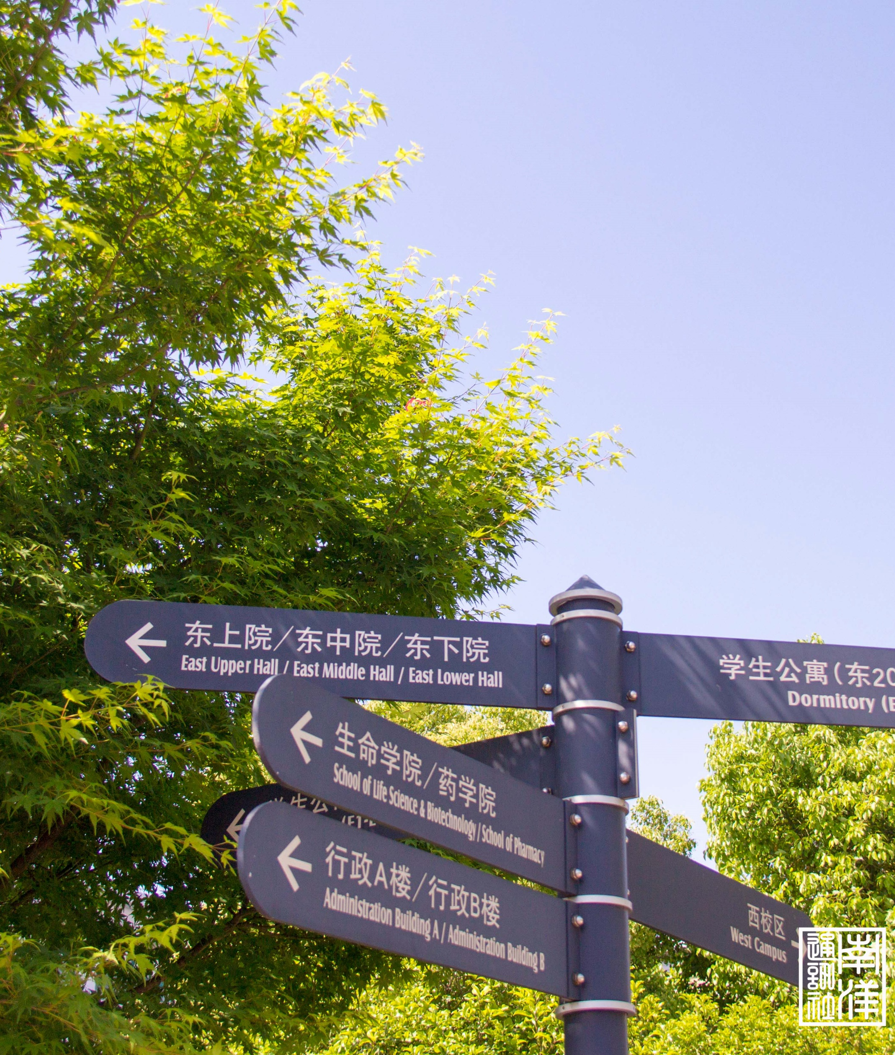
App Introduction
02
All available on my github repo:
https://github.com/Clover-Hill/NeoFlow

Slide 6


03
Live Demo

Slide 7
Summary
04
What’ve I learned from this project

Slide 8
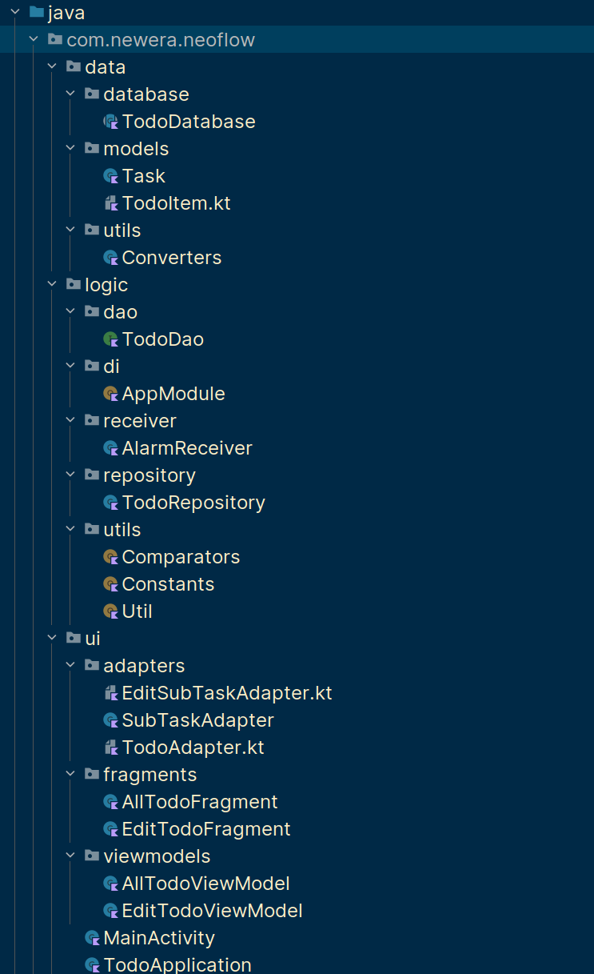
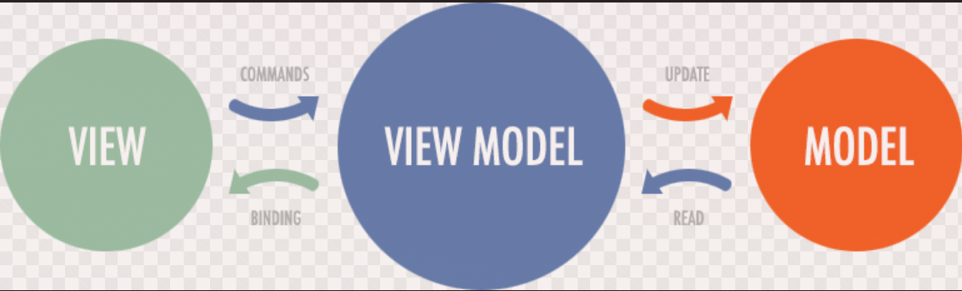
Summary
MVVM Structure

Slide 9
Summary
Data Model
Data Access Object
Adapters
Design
Layout
Data Base
View Model
Fragment

Slide 10
Thanks

